Slide 1

Software Testing & Quality (09)
Usability Testing

Slide 2
Highlights
Why need do Usability Testing
User Interface Testing and Usability Testing
What Makes a Good UI
Testing for the Disabled: Accessibility Testing

Slide 3

What decide customer to choose a product?

Slide 4

Which is important?
Quality
Price
Brand
All are right! But the importance is what the customer like

Slide 5
What is usability?
Easy to discover
Easy to learn
Easy to use
Availability

Slide 6
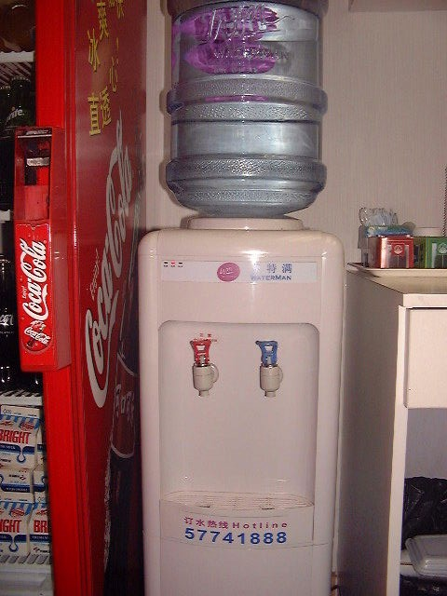
How to get good usability?
易见 Visibility
映射 Mapping
反馈 Feedback

Slide 7
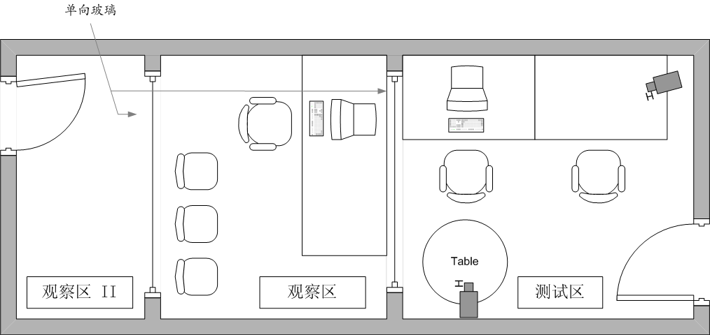
Usability test in Microsoft
180 Usability test engineers
25 Usability test Lab

Slide 8

UI/Usability Testing
UI is User Interface
  Obtain user input
  Display the results
Usability is how appropriate, functional, and effective that interaction is
A good UI determine the usability of product
GUI’s need USABILITY testing
The main content of usability testing is UI testing

Slide 9
What Makes a Good UI
Follows Standards or Guidelines
Intuitive
Correct
Consistent
Flexible
Comfortable
Useful
Simple

Slide 10
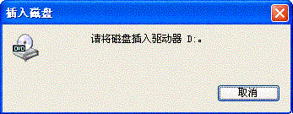
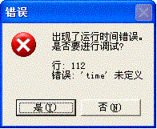
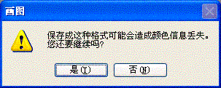
Follows Standards or Guidelines
Follows existing standards and guidelines – or has a really good reason not to
Have accounted for a great deal of formal testing, experience, and trial and error to devise rules that work well for their users
You may create the usability
standards for your software

Slide 11
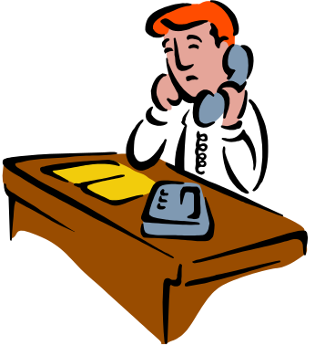
Intuitive
Is the user interface clean, unobtrusive, not busy?
Is the UI organized and laid out well?
Does it allow you to easily get from one function to another?
Is there excessive functionality?
If all else fails, does the help system really help you?
客户：喂，你们的产品我不会用。
技术支持：你可以看说明书啊！
客户：可是你们的说明书有300多页啊，而且我也看不太懂。
技术支持：这样啊，我们建议你首先自学计算机专业本科的课程。
客户：…，算了我还是不要用了！！！

Slide 12
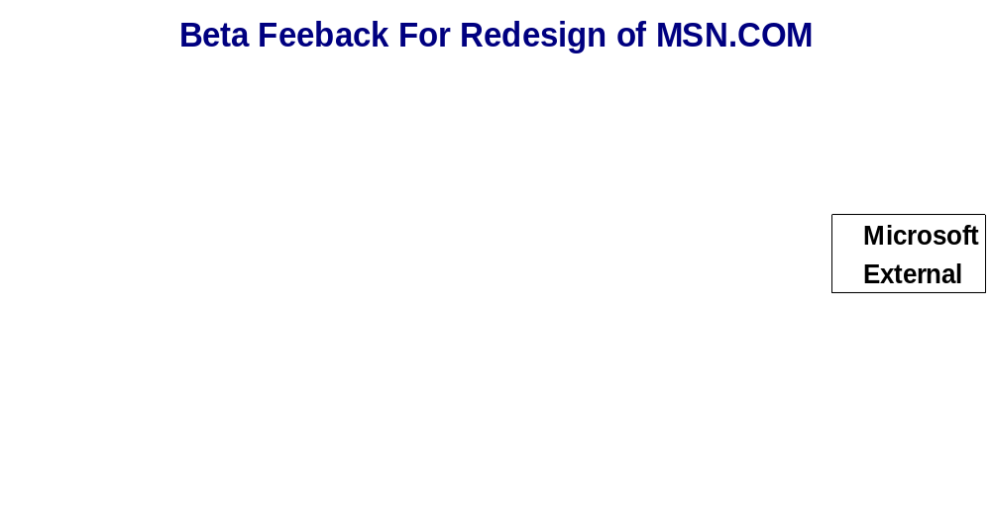
Different experience from different users
% of Responses

Slide 13
Correct
Marketing Differences
Language and Spelling
Bad media
WYSIWYG (what you see is what you get)

Slide 14
Consistent
Shortcut keys and menu selection
  example, F1 - help
Terminology and naming
  “find” vs “Search”
Audience
Placement and keyboard equivalents for buttons
  Color, Shape, Text, Operation, …

Slide 15

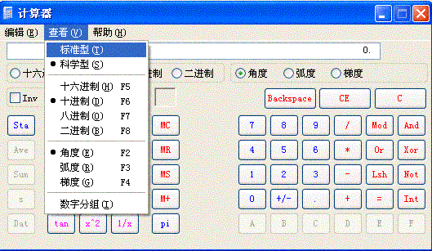
Flexible
State jumping
State termination and skipping
Data input and output
  type, paste, load file, insert object, drag, …

Slide 16
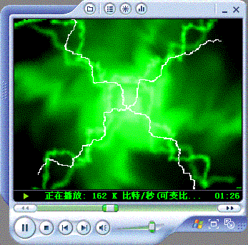
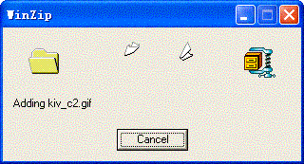
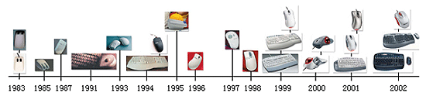
Comfortable
Appropriateness: not too garish,
not too plain, …
Error handling
Performance

Slide 17
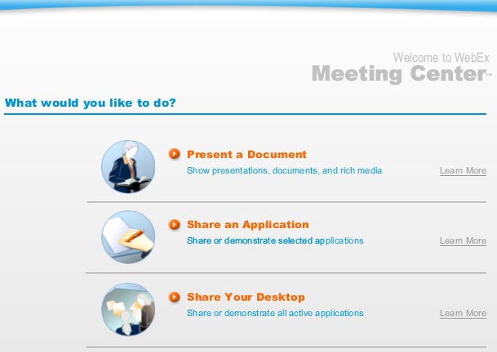
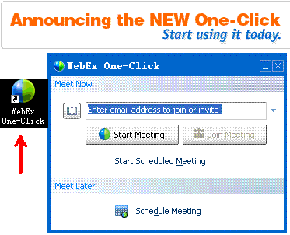
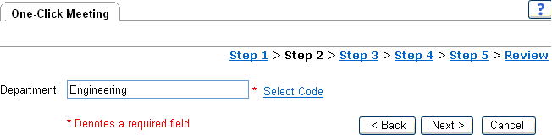
Simple
1-click
Next → Next → Next …

Slide 18
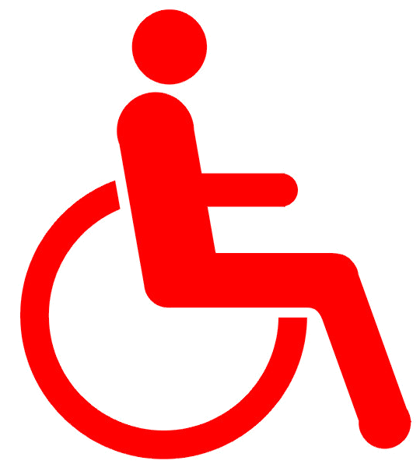
Testing for the disabled:
- Accessibility Testing
Visual impairments: Color blindness, extreme near and far sightedness, tunnel vision, dim vision, blurry vision
Hearing impairments: someone may be partially or completely deaf, have problems hearing certain frequencies, … Voice or sound that accompany an onscreen video, audible help or system alerts.
Motion impairments: It may be difficult or impossible for some people to properly use a keyboard or a mouse, …
Cognitive and language: Dyslexia and memory problem may make it difficult for someone to use complex user interfaces
It’s the Law – help the disabled

Slide 19
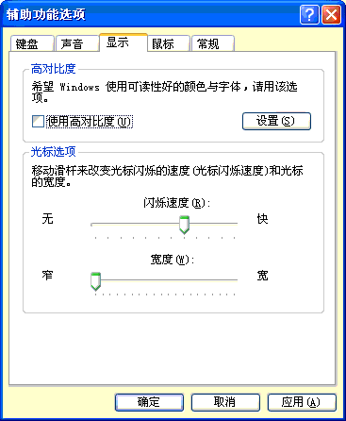
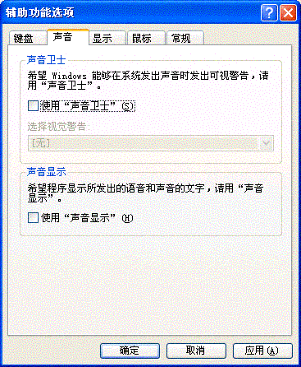
Example

Slide 20
Exercise
Software Testing, Page 182: 3, 4
  If there's no definitive right or wrong user interface, how can it be tested?
  List some examples of poorly designed or inconsistent UIs in products you're familiar with

